Slide 1
Effective market promotion with OmniStore
Universal Crowdsourcing Agency OmniGrade

Slide 2
What Is OmniGrade?
Unique business solutions
Professional international experts
Variety of ambitious business problems
Crowdsourcing platform http://omni-v.com ensures:
finding the most effective solutions to the most complex business problems;
forming a group of supporters to the company who can help in its development;
powerful PR- & HR- effect.
What is OmniStore?
storage of valuable and unique prizes to our experts

Slide 3
Crowdsourcing For Business Was Used BY:

Slide 4
How Does It Work?
The client presents his strategic business goals
The discussion is being moderated
The client chooses the best business solution
The client puts this solution into practice
Experts start to discuss how to solve the problems
We analyze the client’s business
We reveal business problems to be solved

Slide 5
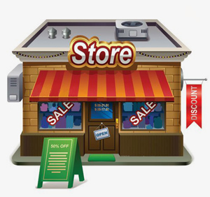
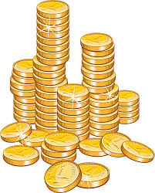
How Do We Attract Experts?
Our experts are professionals in various areas, inspired by the ambitious objectives of our clients. Our international experts on a voluntary basis join the discussion and solve the most complex tasks. In order to thank them for their activities, we have developed a reward system OmniCoins. These are points which can be exchanged in OmniStore.
OmniCoins
OmniStore

Slide 6
Why Is OmniStore a Unique Store?
OmniStore offers rewards to our experts for their work in OmniGrade;
We make slots in OmniStore unique;
These are services, products, special exclusive rewards from companies that are not possible to get anywhere except OmniStore.

Slide 7
Why Does Your Company Need To Be In OmniStore?
You will become part of an innovative global project;
Your brand will be recognized by international audience of socially active people;
We will place your logo and product info on http://omni-v.com/
We will write posts about you in our groups: https://www.facebook.com/omnigrade https://www.linkedin.com/groups/4479541/profile
We will talk about you in our quarterly Newsletter, which we send to all our international partners, experts and customers;
Your expenses are the cost of a few units of your product or service (quantity is up to you).

Slide 8
Possible Variants For OmniStore Lots:
Products or services which your Company produces;
Products or services which your Partner produces;
Invitations to festivals, cultural and sports events;
Tours to the facilities of your company;
Your corporate souvenirs;
special privileges associated with your activity.
If you would like to use the opportunities offered by OmniStore to promote your company, but are unsure of the prize, we are happy to take part in the development of such solutions.

Slide 9
Contacts:
To become an OmniStore supplier email us :
chi_ny@omnigrade.com
To become an expert or find out more about crowdsourcing email us:
tre_mi@omnigrade.com
Join us:
https://www.facebook.com/omnigrade и https://www.linkedin.com/groups/4479541/profile

Slide 10
THANK YOU FOR YOUR ATTENTION!

